Slide 1
How to Build a Sentiment Analysis Program
Name: Grant Martin
Banner Number: B00340010
University of the West of Scotland
Software Development: Assignment 1
Page 1 of 15

Slide 2
Contents
Introduction – What is sentiment Analysis and the purpose of this presentation
Program Design – Explanation of the Program and overview of what is needed to successfully run the program
Training and Testing the Naïve Bayes Classifier
Creating a Module for Sentiment Analysis
Module for Sentiment Analysis to be carried out on live twitter data
Twitter Sentiment Analysis on live tweets
Explanation of the Twitter Sentiment Analysis Program Result
Graphing Live Twitter Sentiment Analysis
Self-Reflection
References
Page 2 of 15

Slide 3
Introduction – What is sentiment Analysis and the purpose of this presentation
What is Sentiment Analysis? Sentiment Analysis is the measure of positive and negative language or text. It is a method of gauging written or spoken language to determine if the statement is favourable, unfavourable or neutral and to what extent.
This presentation will give a detailed description of my program and it will explain how my sentiment analysis program was built, explaining in detail the code I used and what it does within the program providing descriptions of what packages do and how they work. Finally, at the end of this presentation I will make my final comments about the project as a whole, discussing any problems or difficulties and a final conclusion.
Overview of the Program we intend to Build
When building your own software program, it is also important to plan your project and understand what pieces of code you need before you start, for this program I have drawn up a program design flow diagram informing us what we need to build this sentiment analysis program. See Diagram on the next slide.
Page 3 of 15

Slide 4
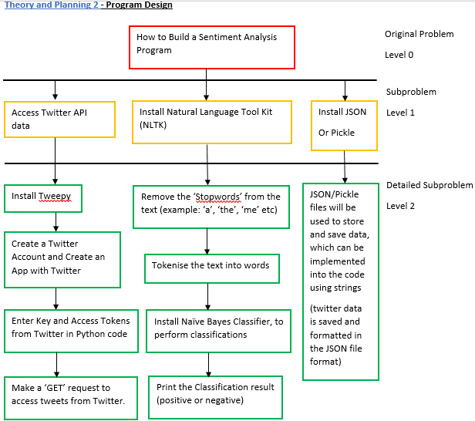
Program Design – Explanation of the Program and overview of what is needed to successfully run the program
Page 4 of 15

Slide 5
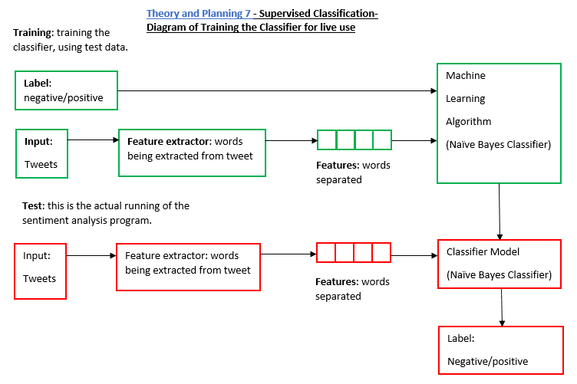
Training and Testing the Naïve Bayes Classifier
Page 5 of 15
Notes:
Theory and Planning 8 - What is Supervised Classification?
The algorithm I will be using to classify the tweets as positive or negative is the Naïve Bayes Classifier, it is a popular algorithm for classifying text data. Supervised classification works by separating the data into 2 categorizes training data and test data from the total dataset. Working example, the dataset total could be 2000 and this is split into 2 categorizes training data which has 1500 datasets and test data which has 500 datasets.
1500 (training data) + 500 (test data) = 2000 (total dataset)
So, the total dataset is used to train and test the classifier of the program.
“This is called supervised machine learning, because we're showing the machine data, and telling it "hey, this data is positive," or "this data is negative." Then, after that training is done, we show the machine some new data and ask the computer, based on what we taught the computer before, what the computer thinks the category of the new data is.”

Slide 6
Training and Testing Naïve Bayes Classifier
classifier = nltk.NaiveBayesClassifier.train(training_set)
#classifier_f = open("naivebayes.pickle", "rb")
#classifier = pickle.load(classifier_f)
#classifier_f.close()
print("Classifier accuracy percent:",(nltk.classify.accuracy(classifier, testing_set))*100)
classifier.show_most_informative_features(15)
save_classifier = open("naivebayes.pickle","wb")
pickle.dump(classifier, save_classifier)
save_classifier.close()
Page 6 of 15
Notes:
# The below code defines and trains my naive bayes classifier
classifier = nltk.NaiveBayesClassifier.train(training_set)
# The 3 lines of code below open the previously saved pickle file to run in the code
#classifier_f = open("naivebayes.pickle", "rb")
#classifier = pickle.load(classifier_f)
#classifier_f.close()
print("Classifier accuracy percent:",(nltk.classify.accuracy(classifier, testing_set))*100)
classifier.show_most_informative_features(15)
# The 2 lines of code above give me a list of the 15 most informative words when the code is run and the accuracy of test data
# The code below allows me to save the naive bayes classifier process of running through the dataset
# By inserting import pickle at the top of the code, I can serialize the classifier and load it into my code, this saves time.
save_classifier = open("naivebayes.pickle","wb")
pickle.dump(classifier, save_classifier)
save_classifier.close()
# The above 3 lines of code saved and stored the results of my code in a pickle file, to be accessed at any point in the future.
# Then I commented off the above code with the ‘#’ to allow me to carry out my next lines of code.
# which involved me uploading the saved data from the pickle file straight back into my code, See below for how it works.
# This opens up a pickle file, preparing to write in bytes some data.
# I used pickle.dump() to dump the data.
# The first parameter to pickle.dump() is what are you dumping.
# The second parameter is where are you dumping it.
# Close the file and now I have a pickle file saved.

Slide 7
Creating a Module for Sentiment Analysis
import nltk
import random
import pickle
from nltk.classify import ClassifierI
from statistics import mode
from nltk.tokenize import word_tokenize
class VoteClassifier(ClassifierI):
def __init__(self, *classifiers):
self._classifiers = classifiers
def classify(self, features):
votes = []
for c in self._classifiers:
v = c.classify(features)
votes.append(v)
return mode(votes)
def confidence(self, features):
votes = []
for c in self._classifiers:
v = c.classify(features)
votes.append(v)
choice_votes = votes.count(mode(votes))
conf = choice_votes / len(votes)
return conf
short_pos = open("positive.txt", "r").read()
short_neg = open("negative.txt", "r").read()
all_words = []
documents = []
allowed_word_types = ["J"]
for p in short_pos.split('\n'):
documents.append((p, "pos"))
words = word_tokenize(p)
pos = nltk.pos_tag(words)
for w in pos:
if w[1][0] in allowed_word_types:
all_words.append(w[0].lower())
# The above if statement is saying if the word is an adjective I want to append that word
Page 7 of 15
Notes:
import nltk
import random
import pickle
from nltk.classify import ClassifierI
#from statistics import mode
from nltk.tokenize import word_tokenize
# import nltk gives me access to the nltk libraries of data and programs for data analysis
# import random will be used to shuffle my training and testing dataset of short movie reviews
# to make the classifier accurate and reliable when processing live tweets
# My dataset has already been labelled as positive and negative, making it possible to train and test with
# import pickle will insert my previously saved and serialised file of my naive bayes classifier and most common 5000 words
# word_tokenize will tokenizes the dataset, separating each word from the body of text as tokens
# I imported mode, this will choose the most popular classifier vote (this code was used when I had more classifiers in the code)
# Line classifierI is the classifier being used on the data
# The class below is for my classifier
# The classifier is called VoteClassifier and is inherting ClassifierI
# The classifiers well in this case the naive bayes classifier is programmed to pass through the class to self.classifier
# In the second function 'def classify' I define my classify process, so I can call on it later on.
# The functions below are passing through the classifier and classifying by features
# The classification is being processed as a vote (was more effective when I had more classifiers)
# Finally the class returns the the mode(vote), the most popular classifier (again better when you have more classifiers)
class VoteClassifier(ClassifierI):
def __init__(self, *classifiers):
self._classifiers = classifiers
def classify(self, features):
votes = []
for c in self._classifiers:
v = c.classify(features)
votes.append(v)
return mode(votes)
def confidence(self, features):
votes = []
for c in self._classifiers:
v = c.classify(features)
votes.append(v)
choice_votes = votes.count(mode(votes))
conf = choice_votes / len(votes)
return conf
# confidence function is simply counting up the votes for each classifiers (again working better when you use more classifiers)
# See the user guide for instructions on how to download the positive and negative.txt files for training and testing classifier.
# 2 two lines below open the text files and reads the text data contained within.
short_pos = open("positive.txt", "r").read()
short_neg = open("negative.txt", "r").read()
all_words = []
documents = []
# all_words equals empty list
# documents equals empty list
# j is adjective, r is adverb, and v is verb
# allowed_word_types = ["J","R","V"]
allowed_word_types = ["J"]
# I am only looking for adjectives in the dataset
for p in short_pos.split('\n'):
documents.append((p, "pos"))
words = word_tokenize(p)
pos = nltk.pos_tag(words)
for w in pos:
if w[1][0] in allowed_word_types:
all_words.append(w[0].lower())
# The above if statement is saying if the word is an adjective I want to append that word
for p in short_neg.split('\n'):
documents.append((p, "neg"))
words = word_tokenize(p)
pos = nltk.pos_tag(words)
for w in pos:
if w[1][0] in allowed_word_types:
all_words.append(w[0].lower())
# The above if statement is saying if the word is an adjective I want to append that word
# Below I am saving the words in a pickle file
save_documents = open("documents.pickle", "wb")
pickle.dump(documents, save_documents)
save_documents.close()
# The above 3 lines of code saved and stored the results of my code in a pickle file, to be accessed at any point in the future.
all_words = nltk.FreqDist(all_words)
# The line of code above will form a list of the most common words in the text files.
word_features = list(all_words.keys())[:5000]
# The above line of code records the most common 5000 words from both text files.
save_word_features = open("word_features5k.pickle", "wb")
pickle.dump(word_features, save_word_features)
save_word_features.close()
# The above 3 lines of code saved and stored the results of my code in a pickle file, to be accessed at any point in the future.
def find_features(document):
words = word_tokenize(document)
features = {}
for w in word_features:
features[w] = (w in words)
return features
# The line of code below does this to all documents, saving the feature existence booleans and the positive or negative categories
featuresets = [(find_features(rev), category) for (rev, category) in documents]
random.shuffle(featuresets)
#This mixes up the positive and negative featuresets
print(len(featuresets))
# The line of code above prints the length of the dataset (total number of positive and negative datasets)
# dataset I will test classifier against
testing_set = featuresets[10000:]
# dataset I will train classifier with
training_set = featuresets[:10000]
classifier = nltk.NaiveBayesClassifier.train(training_set)
print("Original Naive Bayes Algo accuracy percent:", (nltk.classify.accuracy(classifier, testing_set)) * 100)
classifier.show_most_informative_features(15)
# The above lines of code will print the percentage accuracy of the naive bayes classifier and the 15 most common words
save_classifier = open("originalnaivebayes5k.pickle", "wb")
pickle.dump(classifier, save_classifier)
save_classifier.close()
# The above 3 lines of code saved and stored the results of my code in a pickle file, to be accessed at any point in the future.
# 'open' create a new pickle file
# 'wb' means write in bytes
# I used pickle.dump() to dump the data.
# The first parameter to pickle.dump() is what are you dumping.
# The second parameter is where are you dumping it.
# Close the file and now I have a pickle file saved.
# Reference for code used: https://pythonprogramming.net/sentiment-analysis-module-nltk-tutorial/

Slide 8
Module for Sentiment Analysis to be carried out on live twitter data
In this file of code, I was creating the function to carry out live sentiment analysis on live tweets from Twitter. In this file of code I simply imported my classifier and opened all the pickle files from the previous pieces of code which have be storing the process for sentiment analysis to be carried out, including: the classifier/5000 word features etc. Also, I tokenized the word features in the pickle file document.
# The last piece of code is the most important piece of code for the next python files
# The function called 'sentiment' is created and takes the text, analyses the features of the text using find_features and returns the sentiment (positive or negative)
def sentiment(text):
feats = find_features(text)
return voted_classifier.classify(feats), voted_classifier.confidence(feats)
Page 8 of 15
Notes:
import random
import pickle
#from nltk.classify import ClassifierI
#from statistics import mode
from nltk.tokenize import word_tokenize
# import random will be used to shuffle my training and testing dataset of short movie reviews
# to make the classifier accurate and reliable when processing live tweets
# My dataset has already been labelled as positive and negative, making it possible to train and test with
# import pickle will insert my previously saved and serialised file of my naive bayes classifier and most common 5000 words
# word_tokenize will tokenizes the dataset, separating each word from the body of text as tokens
# The class below is for my classifier
# The classifier is called VoteClassifier and is inherting ClassifierI
# The classifiers well in this case the naive bayes classifier is programmed to pass through the class to self.classifier
# In the second function 'def classify' I define my classify process, so I can call on it later on.
# The functions below are passing through the classifier and classifying by features
# The classification is being processed as a vote (was more effective when I had more classifiers)
# Finally the class returns the the mode(vote), the most popular classifier (again better when you have more classifiers)
class VoteClassifier(ClassifierI):
def __init__(self, *classifiers):
self._classifiers = classifiers
def classify(self, features):
votes = []
for c in self._classifiers:
v = c.classify(features)
votes.append(v)
return mode(votes)
def confidence(self, features):
votes = []
for c in self._classifiers:
v = c.classify(features)
votes.append(v)
choice_votes = votes.count(mode(votes))
conf = choice_votes / len(votes)
return conf
# confidence function is simply counting up the votes for each classifiers (again working better when you use more classifiers)
# The 3 lines of code below are simply opening the pickle file of the documents, I created in the last piece of code.
documents_f = open("documents.pickle", "rb")
documents = pickle.load(documents_f)
documents_f.close()
# The 3 lines of code below are simply opening the pickle file of the word features, I created in the last piece of code.
word_features5k_f = open("word_features5k.pickle", "rb")
word_features = pickle.load(word_features5k_f)
word_features5k_f.close()
# The lines of code below are creating a function (def) to tokenize the words contained within the document
def find_features(document):
words = word_tokenize(document)
features = {}
for w in word_features:
features[w] = (w in words)
return features
# The line of code below does this to all documents, saving the feature existence booleans and the positive or negative categories
featuresets = [(find_features(rev), category) for (rev, category) in documents]
#This mixes up the positive and negative featuresets
random.shuffle(featuresets)
print(len(featuresets))
# The line of code above prints the length of the dataset (total number of positive and negative datasets)
# dataset I will test classifier against
testing_set = featuresets[10000:]
# dataset I will train classifier with
training_set = featuresets[:10000]
# The 3 lines of code below are opening the pickle file of the naive bayes classifier
# The pickle file has saved the classifier, this reduces the run time of the program especially if being used on large dataset
open_file = open("originalnaivebayes5k.pickle", "rb")
classifier = pickle.load(open_file)
open_file.close()
voted_classifier = VoteClassifier(
classifier)
# The last piece of code is the most important piece of code for the next python files
# The function called 'sentiment' is created and takes the text, analyses the features of the text using find_features and returns the sentiment (positive or negative)
def sentiment(text):
feats = find_features(text)
return voted_classifier.classify(feats), voted_classifier.confidence(feats)
# Reference for the code used: https://pythonprogramming.net/sentiment-analysis-module-nltk-tutorial/

Slide 9
Twitter Sentiment Analysis on live tweets
from tweepy import Stream
from tweepy import OAuthHandler
from tweepy.streaming import StreamListener
import json
import sentiment_mod as s
# The above import sentiment_mod as s line of code imports the sentiment analysis fuction from the last piece of code.
# tweepy is the python client for the official Twitter API to gather tweets through Twitter API
# To receive your own consumer key and secret, access token and secret
# You need to view my user guide for the instructions on how to do this
# Consumer keys and access tokens, used for OAuth (OAuthentication)
# It is used for security and to make sure you have permission to use the Twitter API data
consumer_key = “Use your own"
consumer_secret = “Use your own"
access_token = “Use your own"
access_secret = "Use your own"
Page 9 of 15

Slide 10
Twitter Sentiment Analysis on live tweets
# Line 4 of the code 'import json' allows me to use the json module to load the tweet data with the code below 'json.loads(data)'
# The line of code below 'tweet = all_data["text"]' allows me to target the tweets specifically
# Once I have a tweet I can pass it through the sentiment_mod
# In the code below the line 'output = open("twitter-out.txt", "a")' and the code that follows will output the tweets into a json file with its sentiment score
class listener(StreamListener):
def on_data(self, data):
all_data = json.loads(data)
tweet = all_data["text"]
sentiment_value, confidence = s.sentiment(tweet)
print(tweet, sentiment_value, confidence)
if confidence * 100 >= 80:
output = open("twitter-out.txt", "a")
output.write(sentiment_value)
output.write('\n')
output.close()
return True
def on_error(self, status):
print(status)
# OAuth process, using the keys and tokens
auth = OAuthHandler(consumer_key, consumer_secret)
auth.set_access_token(access_token, access_secret)
twitterStream = Stream(auth, listener())
twitterStream.filter(track=["justice league"])
# The stream is retreiving all the live tweets about your chosen query, in this case justice league.
Page 10 of 15

Slide 11
Explanation of the Twitter Sentiment Analysis Program Result
Review of Results
From the results of the sentiment analysis we can see the naïve bayes classifier is more negative than positive and we see the biggest problem to sentiment analysis, which is its inability to detect sarcasm.
For example: RT @graham_williams: Imagine saying 10 years ago that an action comedy with a short-haired Thor would open bigger at the box office than… pos 1.0
Problems with this result
The program has not detected the sarcasm from the author of the tweet, as any human with basic knowledge of comic books would know that ‘Thor’ famously has long blonde hair and the author of the tweet is implying that ‘justice league’ is so bad that a film with a not very stereotypical short haired ‘Thor’ is more successful than justice league.
Also, this tweet has been categorized has positive when it is actually a negative tweet about ‘justice league’
Page 11 of 15

Slide 12
Graphing Live Twitter Sentiment Analysis
import matplotlib.pyplot as plt
import matplotlib.animation as animation
from matplotlib import style
import time
# import matplotlib allows me to present the live Twitter data in the form of and line graph, measuring the sentiment of the tweets
# style 'ggplot' just makes the graph look better and pleasing to the eye
style.use("ggplot")
Page 12 of 15

Slide 13
Graphing Live Twitter Sentiment Analysis
# the pullData is the data I will use to construct the graph
# The pullData I will be using is the 'twitter-out.txt' file I created in the last piece of code
# lines equal to pullData split by new line
# 'xar' X array equals empty list
# 'yar' Y array equals empty list
# The line of code 'for l (line) in lines [-200:]:' is saving the graph data when it reaches 200 tweets
# The function below is constructing the graph
# x=0 and y=o are the starting points of the graph
# If the tweet is positive y = plus one and if the tweet is negative y= minus 1
def animate(i):
pullData = open("twitter-out.txt", "r").read()
lines = pullData.split('\n')
xar = []
yar = []
x = 0
y = 0
for l in lines[-200:]:
x += 1
if "pos" in l:
y += 1
elif "neg" in l:
y -= 1
xar.append(x)
yar.append(y)
ax1.clear()
ax1.plot(xar, yar)
ani = animation.FuncAnimation(fig, animate, interval=1000)
plt.show()
Page 13 of 15

Slide 14
Self-Reflection – About the Overall Project
At the start of the project when I was using the movie_reviews NLTK corpus, my naïve bayes classifier was too inaccuracy. Causes for this were too small a dataset to train and test with (1000 negative and 1000 positive reviews)
Early in the project I used the Scikit-Learn pip install to download more classifiers, I thought if I used more classifiers I would improve the programs reliability and accuracy. This was successfully.
Next in the development of my project I stopped using the movie_reviews NLTK corpus and started using small movie review dataset from an online resource, these movie reviews were similar to Twitter data so would improve the accuracy of the sentiment analysis on the live tweets from Twitter.
However, using this new and bigger dataset to train and test the classifiers was unsuccessful, as I kept on receiving a memory error and the program would stop running after running through 2 of my 6 classifiers. I think this problem occurred due to the dataset being too big 10000 for my computer to run through 6 classifiers. However, this was a good investigation.
Final comments about the program itself, the accuracy of the sentiment analysis program was never going to be 100%
To improve the accuracy of the classifiers in the future, I would train and test the classifiers with a bigger dataset with a bigger range of writing styles, emoji’s, sarcasm, slang, spelling mistakes and language. This would improve the performance and accuracy of the program.
Page 14 of 15

Slide 15
References
https://pythonprogramming.net/graph-live-twitter-sentiment-nltk-tutorial/
https://pythonprogramming.net/twitter-sentiment-analysis-nltk-tutorial/
https://pythonprogramming.net/sentiment-analysis-module-nltk-tutorial/
https://pythonprogramming.net/sentiment-analysis-module-nltk-tutorial/
https://pythonprogramming.net/static/downloads/short_reviews/
https://pythonprogramming.net/naive-bayes-classifier-nltk-tutorial/
https://pythonprogramming.net/static/downloads/short_reviews/
https://www.tutorialspoint.com/python/python_classes_objects.htm
https://apps.twitter.com
Clarabridge. (2017). Sentiment Analysis | What is Sentiment Analysis?. [online] Available at: http://www.clarabridge.com/sentiment-analysis/ [Accessed 20 Sep. 2017].
Page 15 of 15

